Slide 1
Arm use asymmetry pilot data
March 24, 2023 – Summary prepared by Bev L
Research question: How does upper limb use asymmetry during daily arm use change in the presence of intermittent vibrotactile sensory cues? Specifically, does non-dominant hand use increase if you instruct a participant to use it more and receive regular vibrotactile reminders?

Slide 2
Experimental Design
Phase 1 (control condition): Normal everyday arm use
72 hours total wear time: Actigraph wrist accelerometers (R and L hands)
Participant instructed to use hands as they normal would in a regular day
Phase 2 (experimental condition): Everyday arm use + vibrotactile feedback
72 hours total wear time: Actigraph wrist accelerometers (R and L hands)
Participant wore a watch on non-dominant hand that delivered a vibration every 20 min over a 12 hr interval each day (36 vibration cues per day). Participant instructed to use vibration as a reminder to try to use non-dominant hand more during the day for appropriate tasks.
Baseline demographics assessment: Handedness (Edinburgh Handedness Questionnaire, occupation, age)
Primary Outcomes (measured at Phase 1 and Phase 2):
Mean Arm Use Ratio (time)
Mean Arm Use Ratio (activity count)

Slide 3
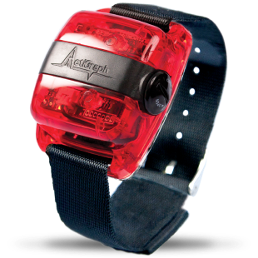
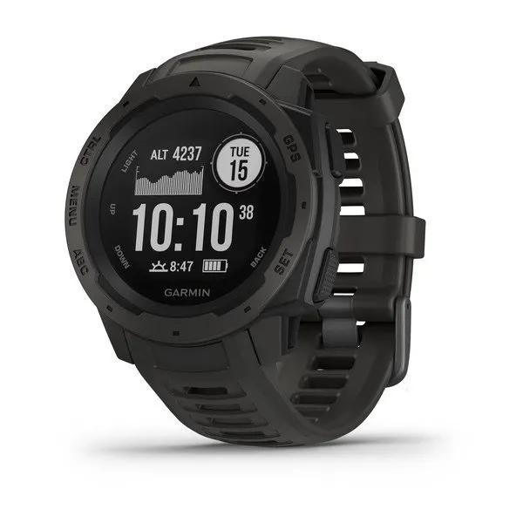
Equipment
Accelerometers: worn on both wrists
Actigraph 3GTx accelerometers (ActiGraph, Florida, USA)
https://theactigraph.com/actigraph-wgt3x-bt
Watch worn on non-dominant (left) wrist, to deliver vibrations:
Garmin Instinct 45mm GPS Watch
https://www.garmin.com/en-CA/p/621802

Slide 4
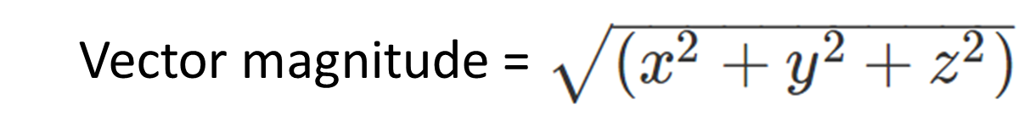
Accelerometry data acquisition & analysis (1/2)
Arm activity was sampled every 1 sec, for 72 consecutive hours for each experimental condition.
Measures acceleration in 3 planes (x, y, z) and quantifies them as “activity counts” using a proprietary algorithm.
A summered vector magnitude was calculated for each 1 sec epoch using a custom Matlab script (using MATLAB version r2021A):
The total amount of time in seconds where Vector Magnitude > 1.99999 was calculated for each 24 hour period for each arm.
Notes:
See also this paper which summarizes the approach to accelerometry data processing that I modelled my analysis off of :https://www.ncbi.nlm.nih.gov/pmc/articles/PMC5565027/

Slide 5
Accelerometry data acquisition & analysis (2/2)
2 Measures of Arm Use Calculated:
(1) Arm use as a measure of time
The total amount of time in seconds where Vector Magnitude > 1.99999 was calculated for each 24 hour period for each arm.
Arm Use Ratio (time) = 100 X (# of seconds of non-dominant arm activity)/(# of seconds of dominant arm activity)
Mean Arm Use Ratio (time) = (Arm use ratio (time) for Day 1 + 2 + 3) / 3
(2) Arm use as a measure of activity counts
The total vector magnitude (VM) was summed for each 24-hr period
Arm Use Ratio (activity count) = 100 X (summed VM non-dominant arm)/(summed VM of dominant arm)
Mean Arm Use Ratio (activity count) = (Arm use ratio (activity count) for Day 1 + 2 + 3) / 3
Notes:
See also this paper which summarizes the approach to accelerometry data processing that I modelled my analysis off of :https://www.ncbi.nlm.nih.gov/pmc/articles/PMC5565027/

Slide 6
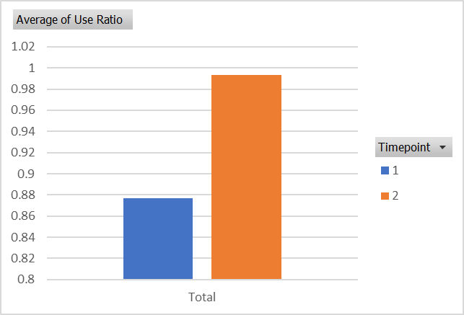
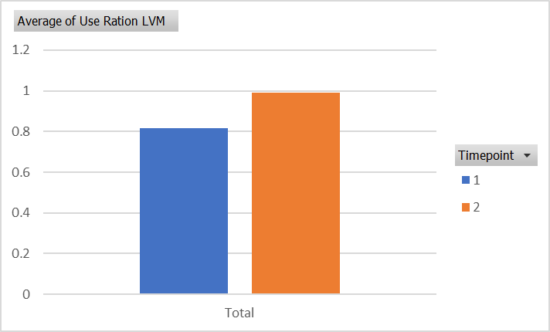
Results:
Mean Arm Use ratio (time)
Demographics:
33 y.o. female,
Dominant hand = Right (Edinburgh Handedness Questionnaire laterality quotient = 100)
occupation: graduate student
Arm use data
 | Phase 1 (control) | Phase 2 (vibration cue)
Mean arm use ratio (time) | 87.7% (SD = 1.2%) | 99.3% (SD = 4.5%)
Mean arm use ratio (activity count) | 81.5% (SD = 4.5%) | 99.0% (SD = 5.1%)
Mean Arm Use ratio (activity count)

